Slide 1
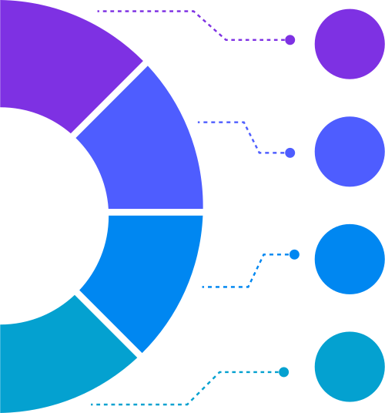
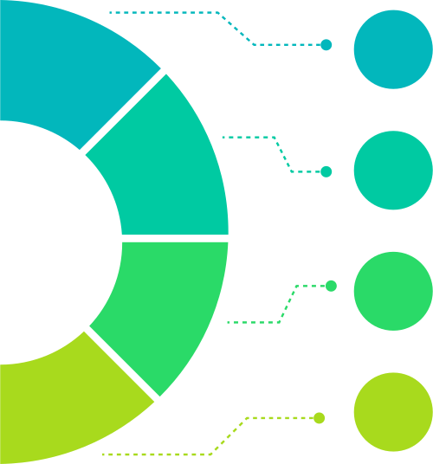



Service Loop Plan
An eight-item loop showing continuous service improvements.
Needs Review
Fix Issues
1
5
Reassess client needs regularly.
Solve any detected problems.
Plan Outline
2
6
Update Flow
Build updated package plans.
Improve future service steps.
Work Action
Report Summary
3
7
Deliver activities as planned
Share results with client.
Check Output
Restart Loop
4
8
Verify service outcomes
Begin again with updated knowledge.

